Slide 1
INSTALLING
MYSQL &
WORKBENCH

Slide 2


Slide 3
Development Environment
Download the MySQL Community Server and Workbench from:
MySQL Community Server
MySQL Workbench

Slide 4

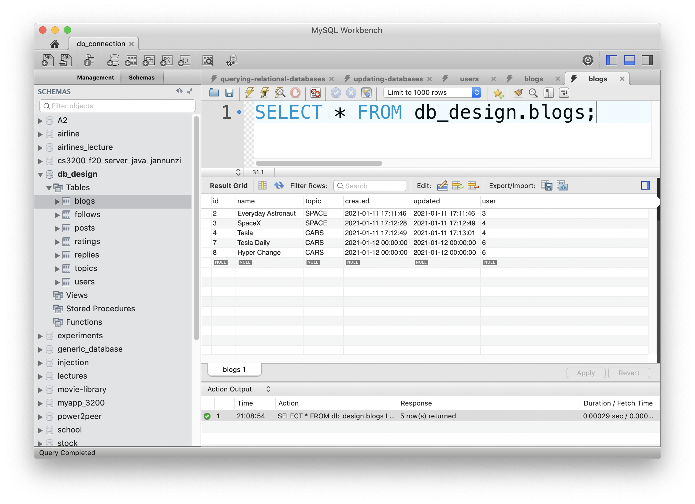
Database Client/Server Architecture
MySQL Workbench Data Files
(Database Client)
MySQL
Server
011010010011
010100010101
101110101001
101010100011

Slide 5
WINDOWS

Slide 6
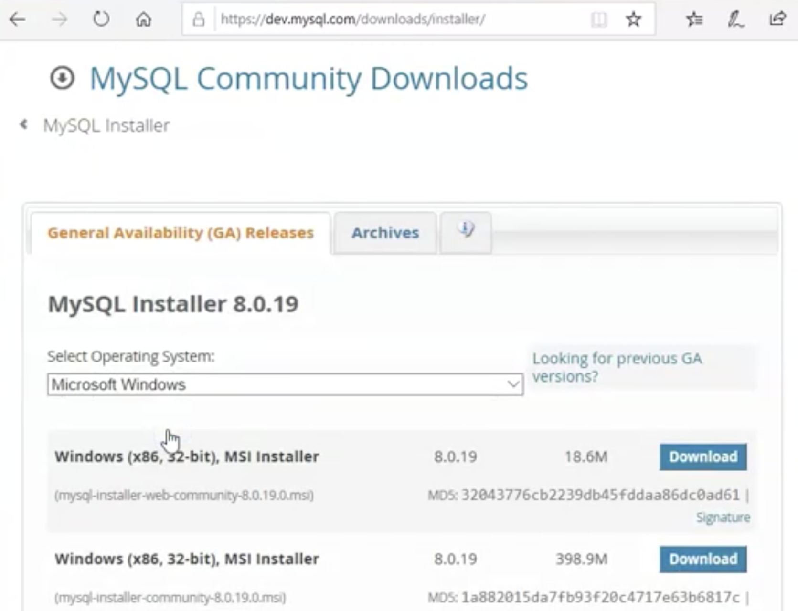
Download MySQL Community Server

Slide 7
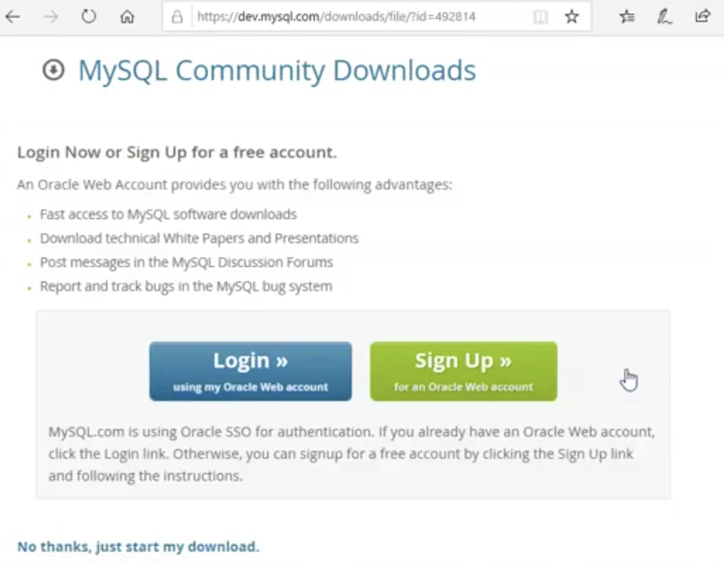
No Thanks

Slide 8
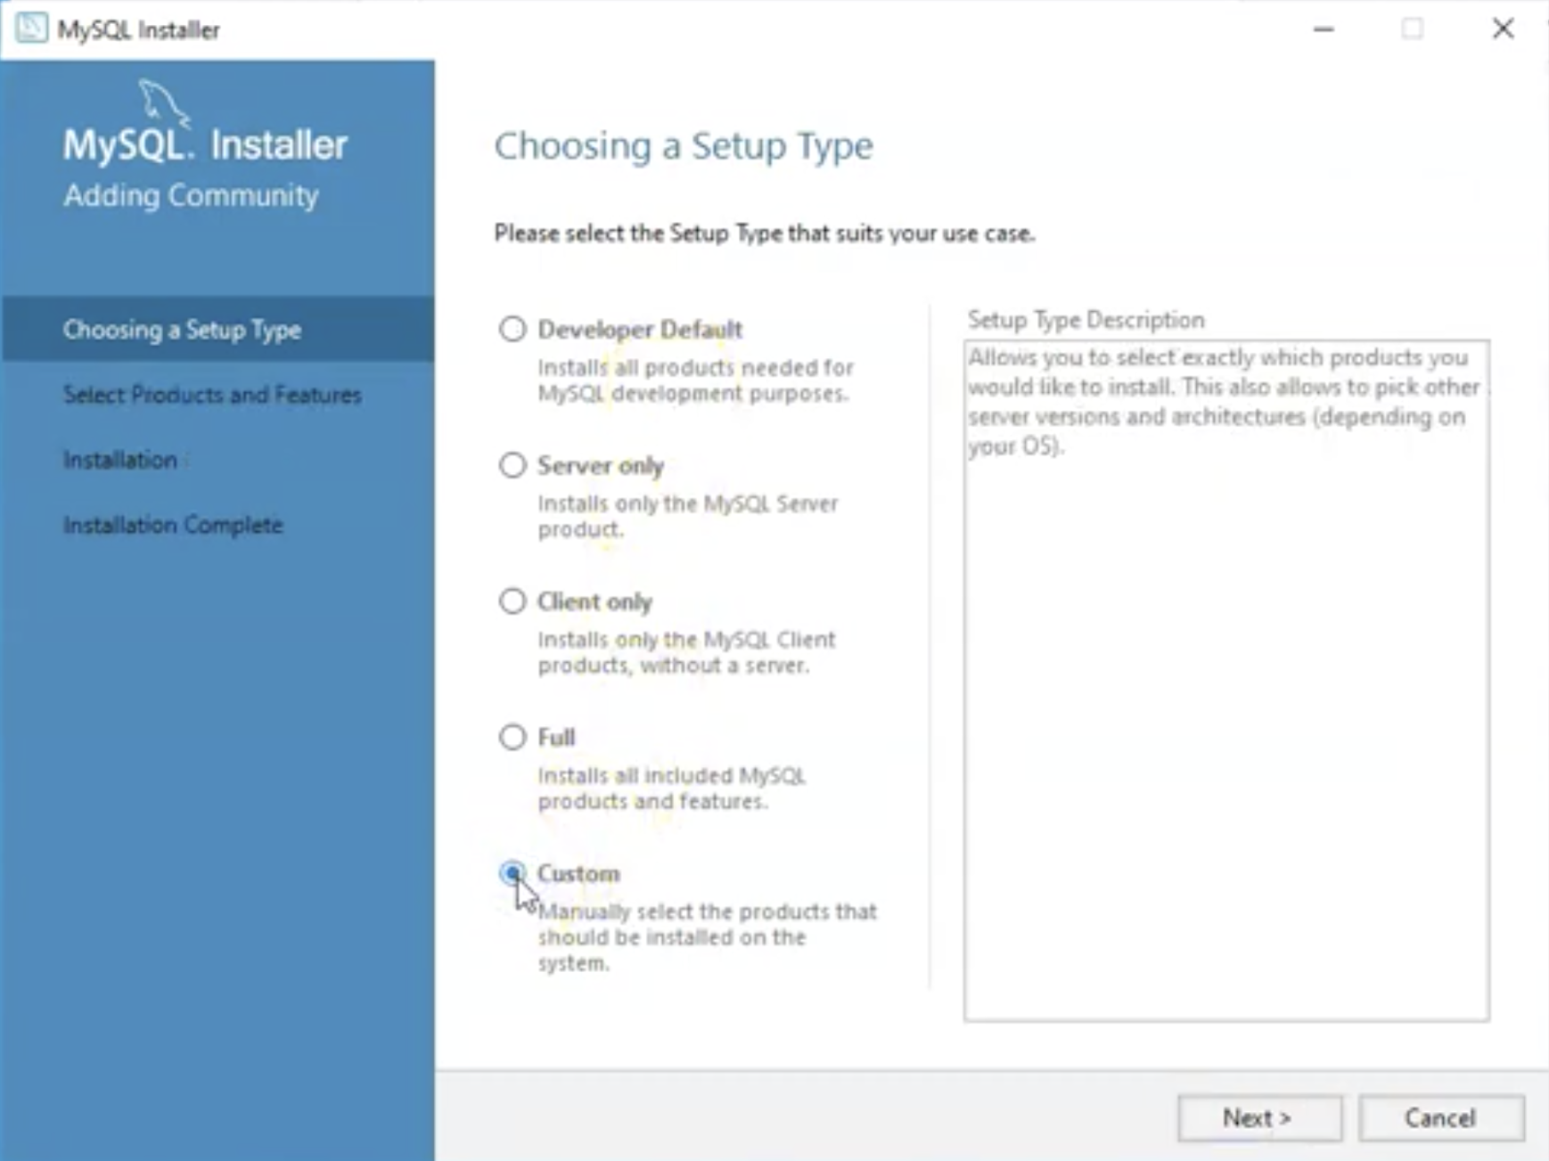
Choose Setup Type: Custom

Slide 9
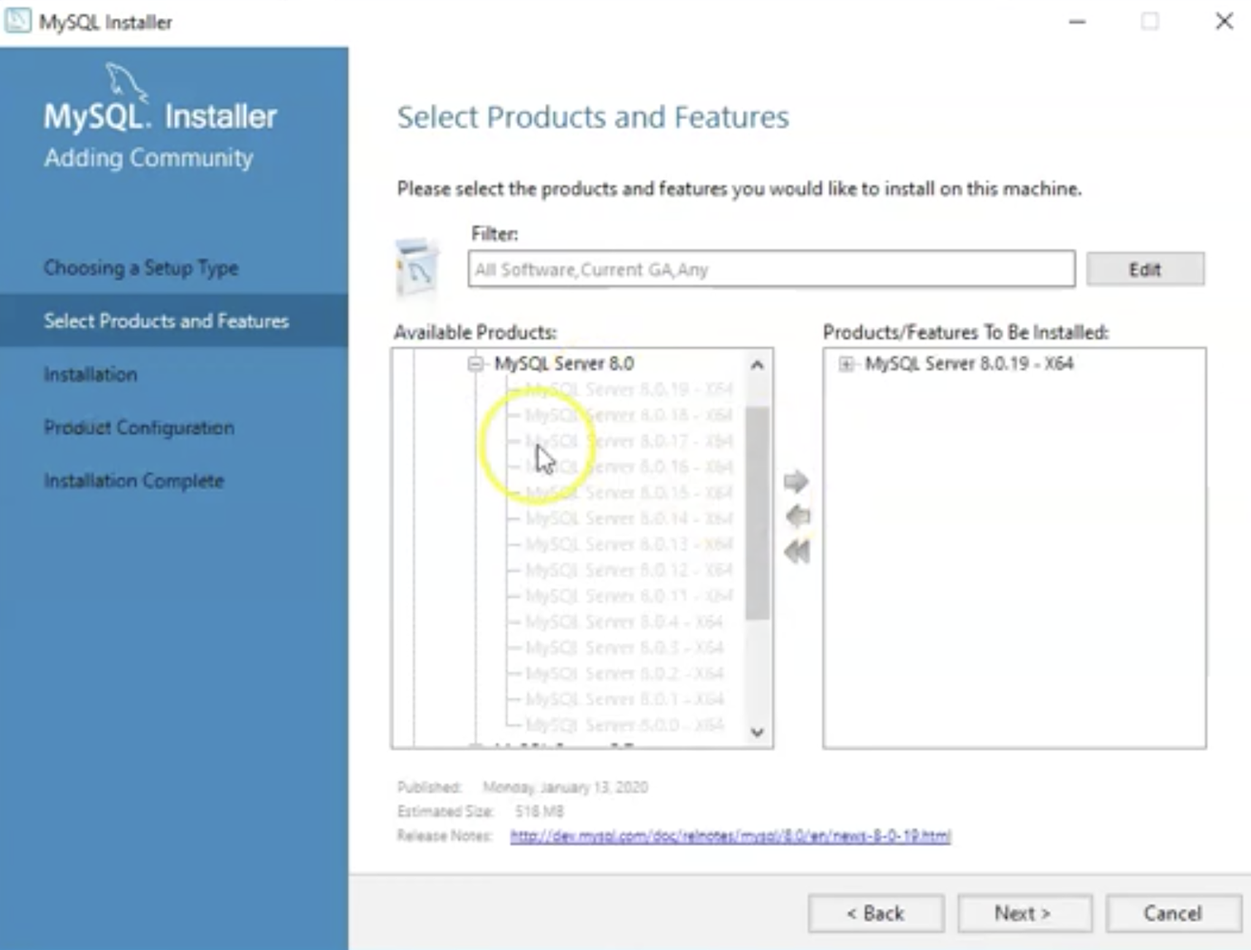
Select Product: MySQL Server

Slide 10
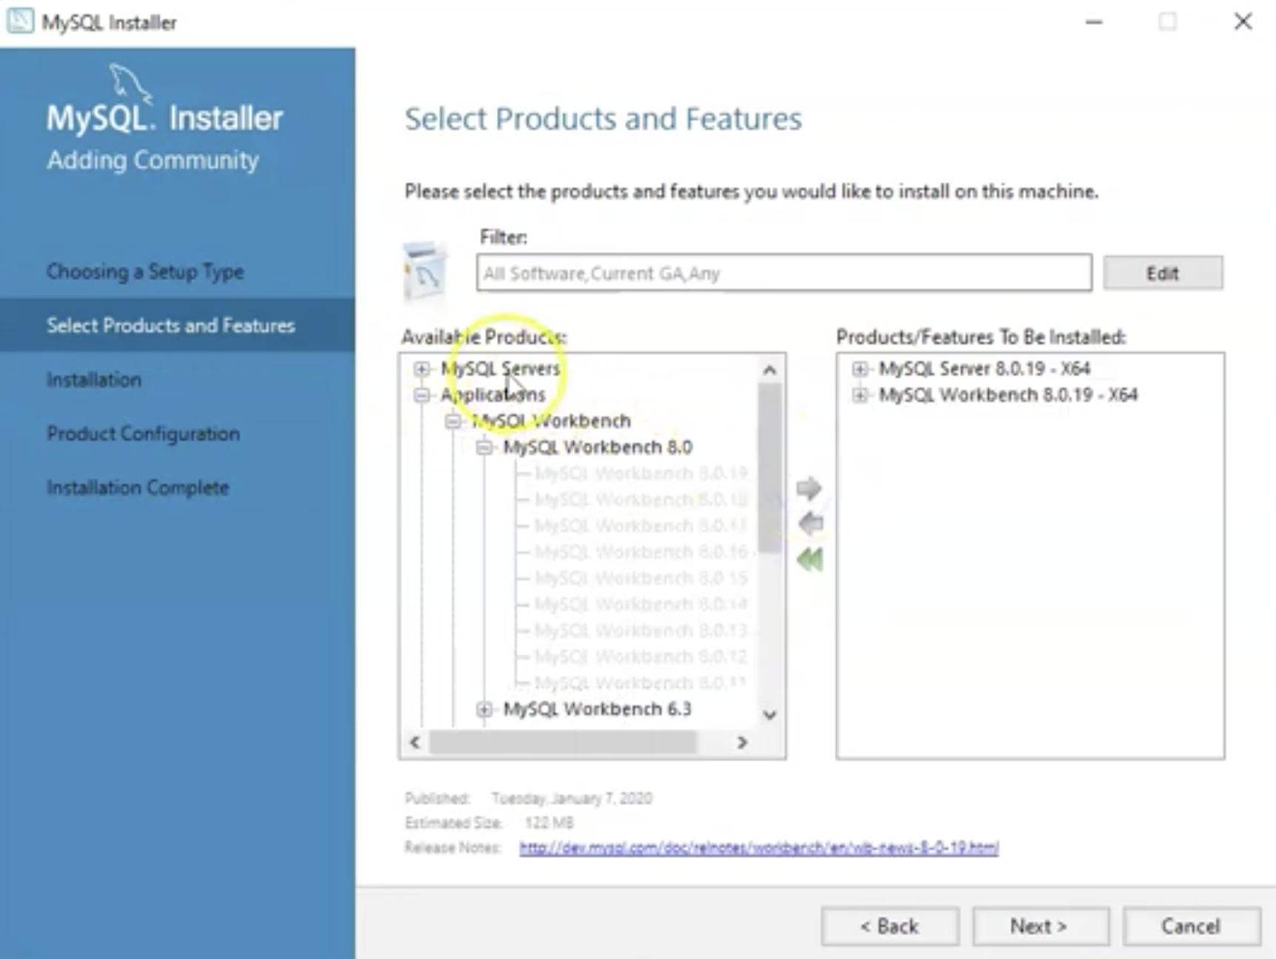
Select Product: MySQL Workbench

Slide 11
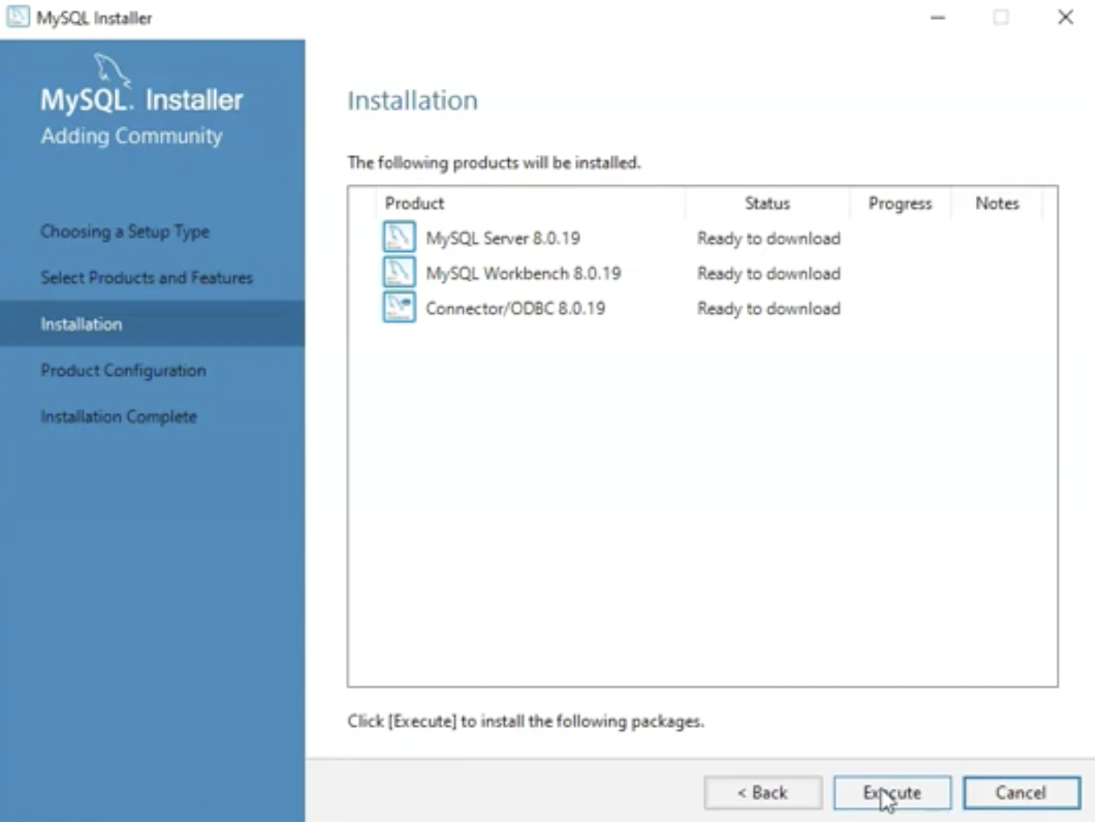
Install

Slide 12
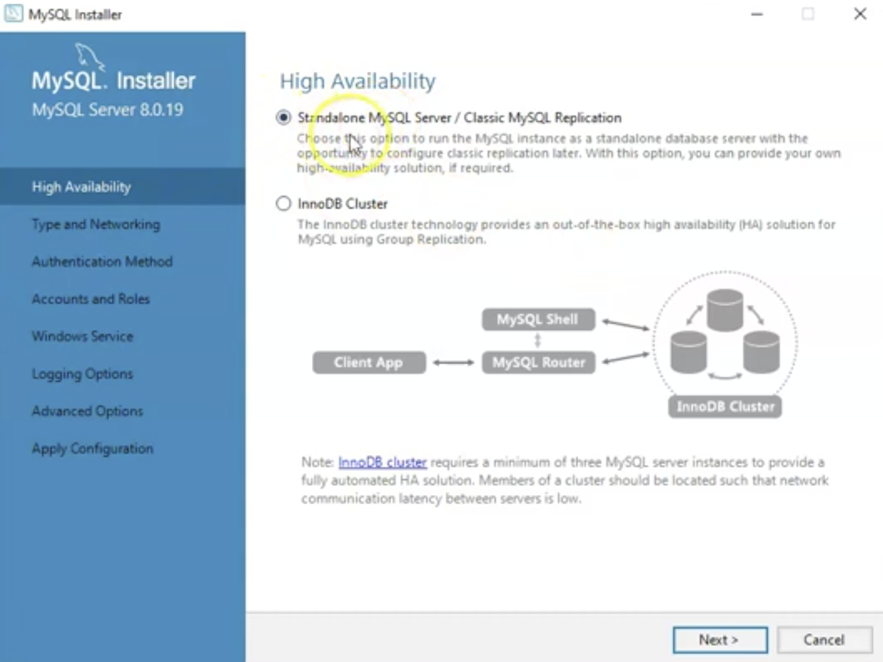
Choose Standalone

Slide 13
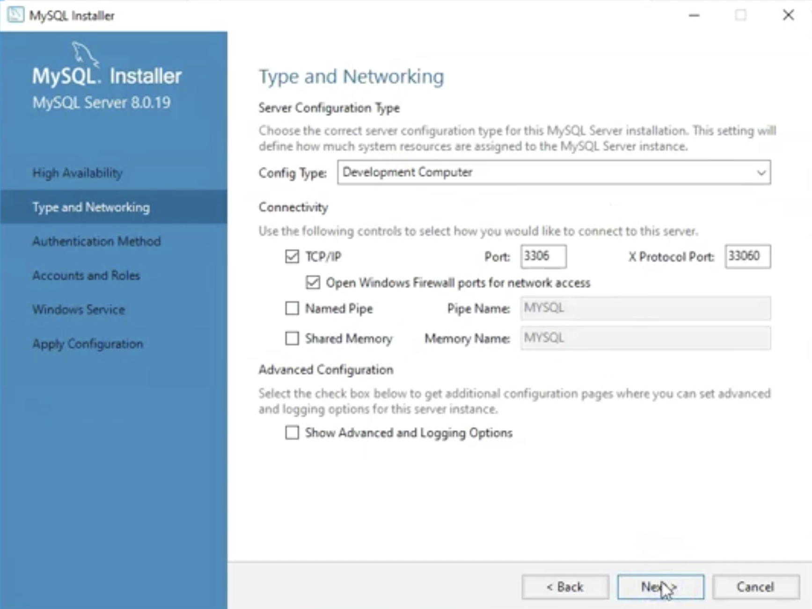
Type and Networking

Slide 14
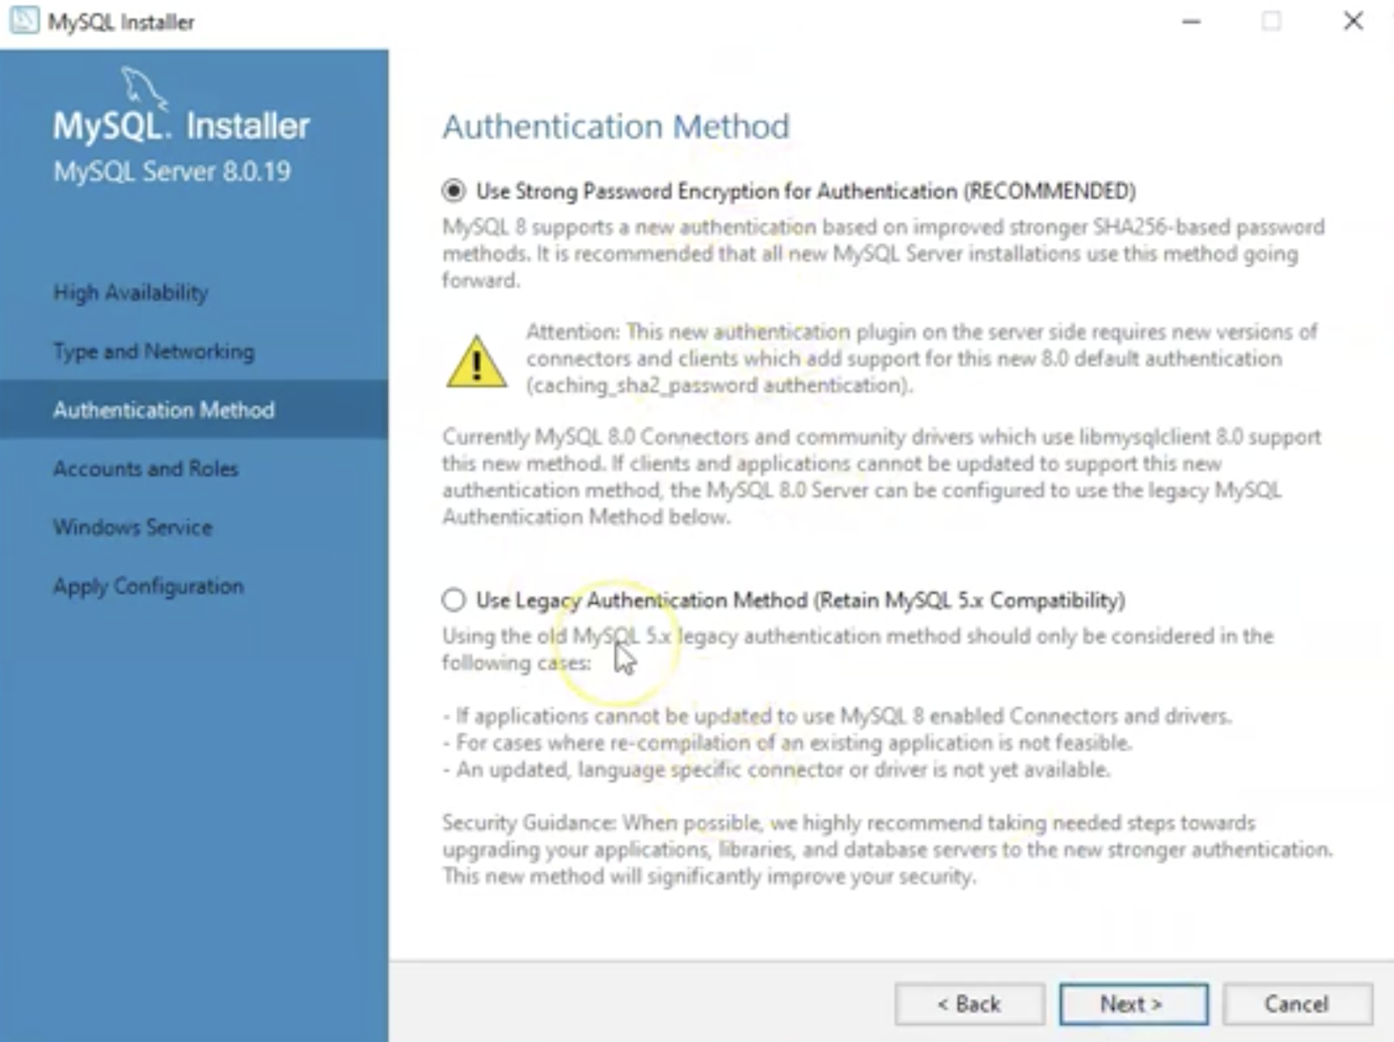
Authentication Method

Slide 15
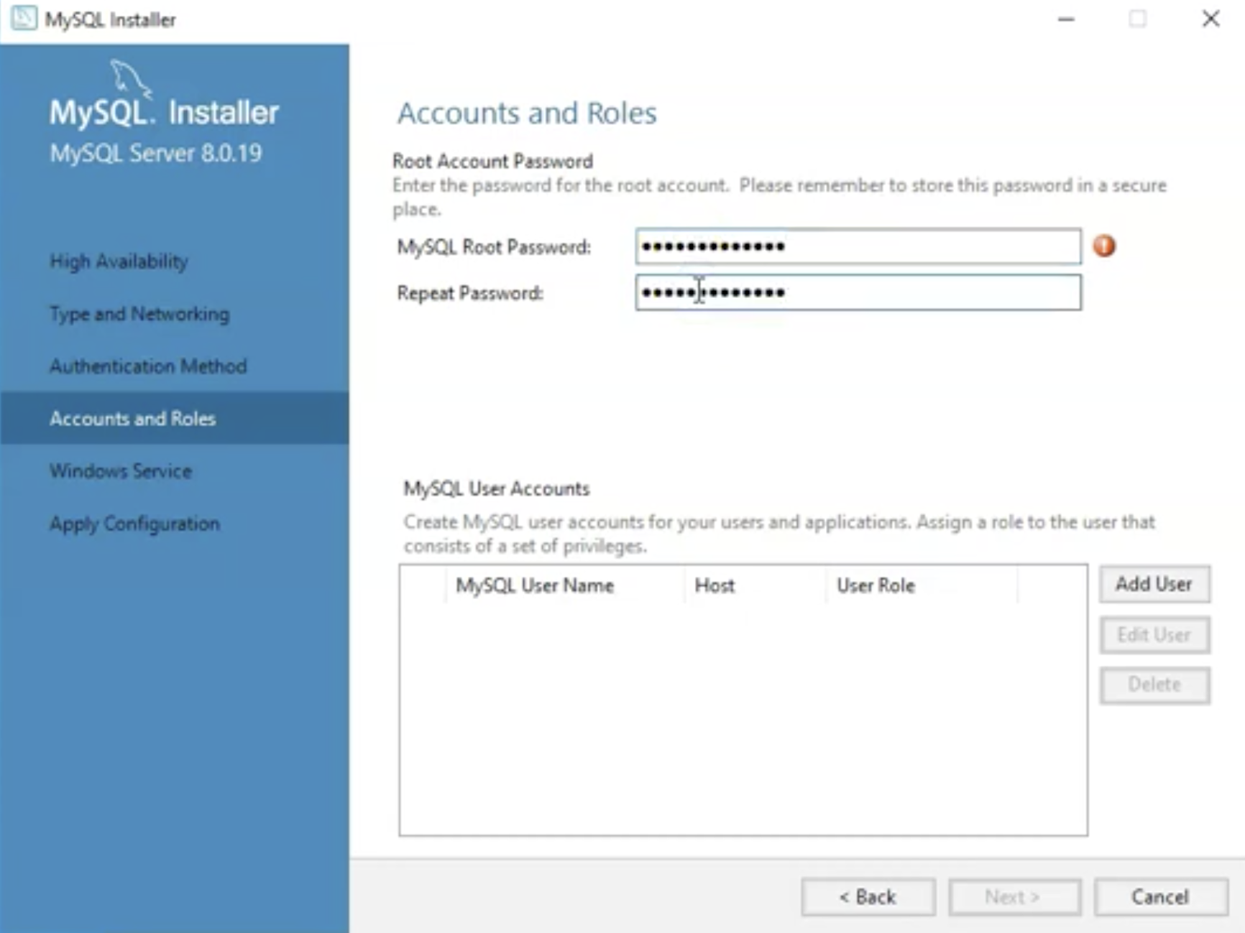
Accounts and Roles
Don't forget the root password!

Slide 16
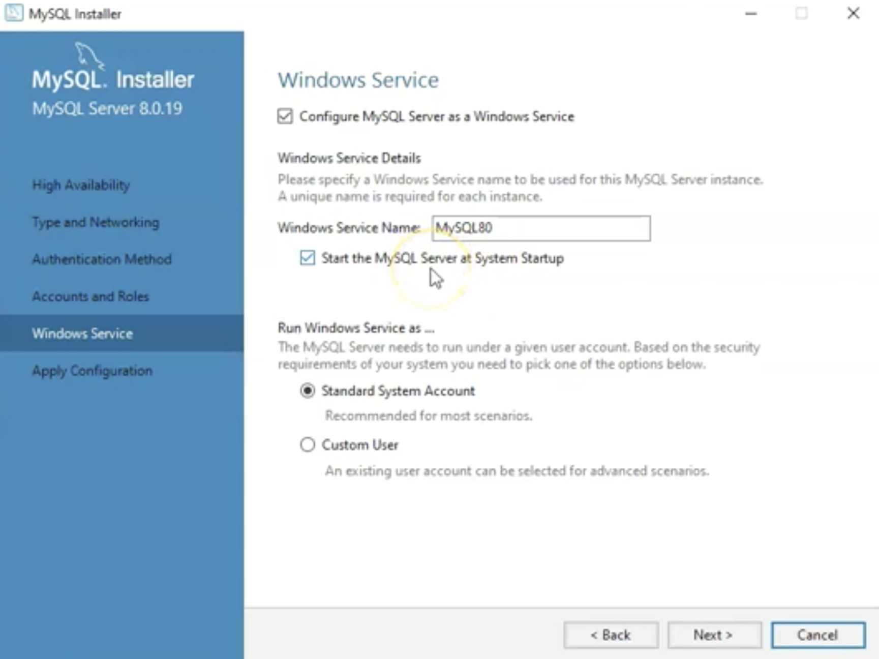
Start Server at System Startup

Slide 17
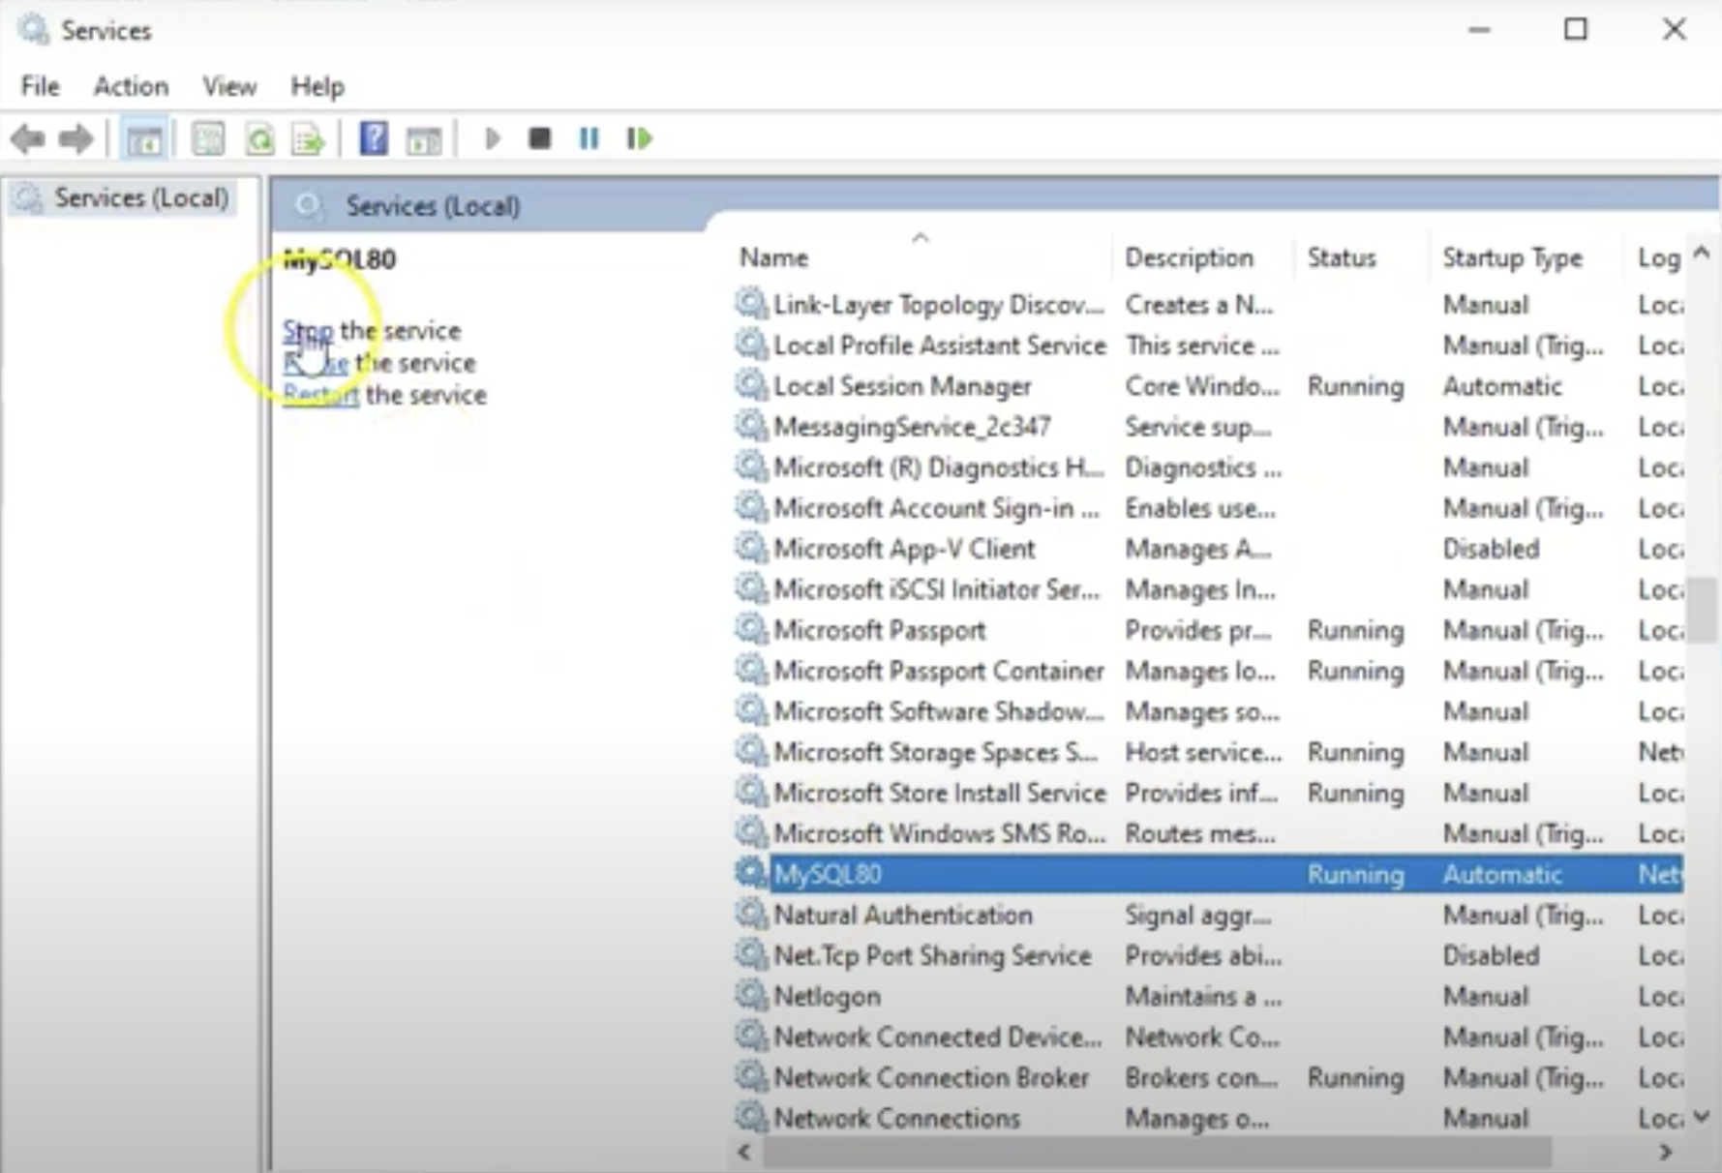
Can Start/Stop Server in Services

Slide 18
macOS

Slide 19
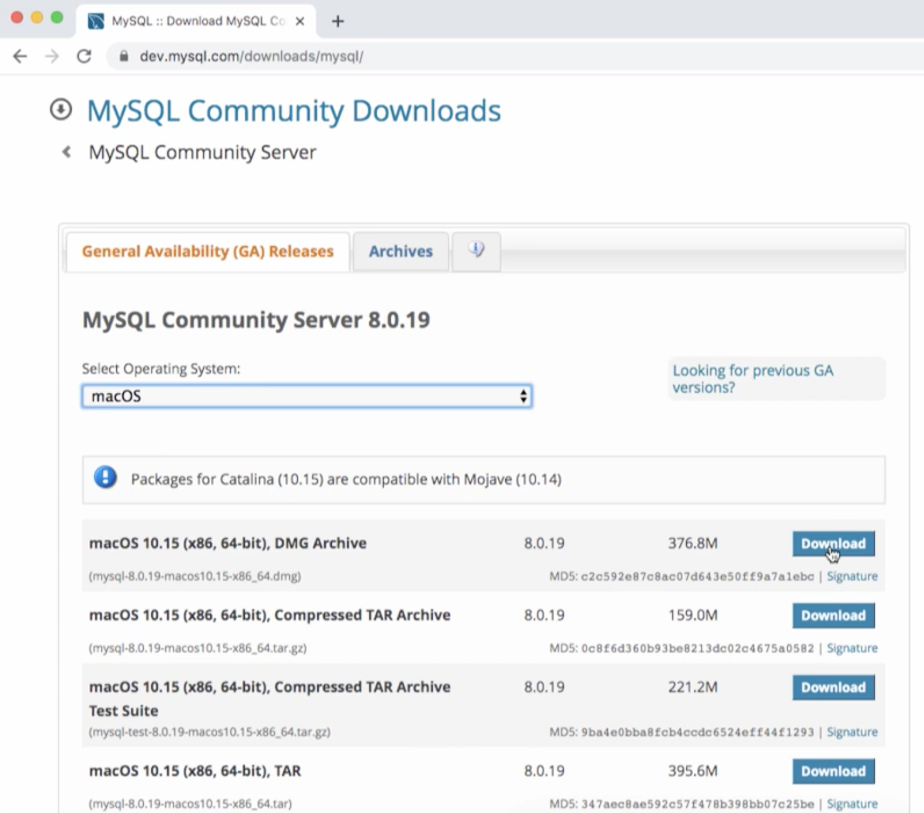
Download MySQL Community Server

Slide 20
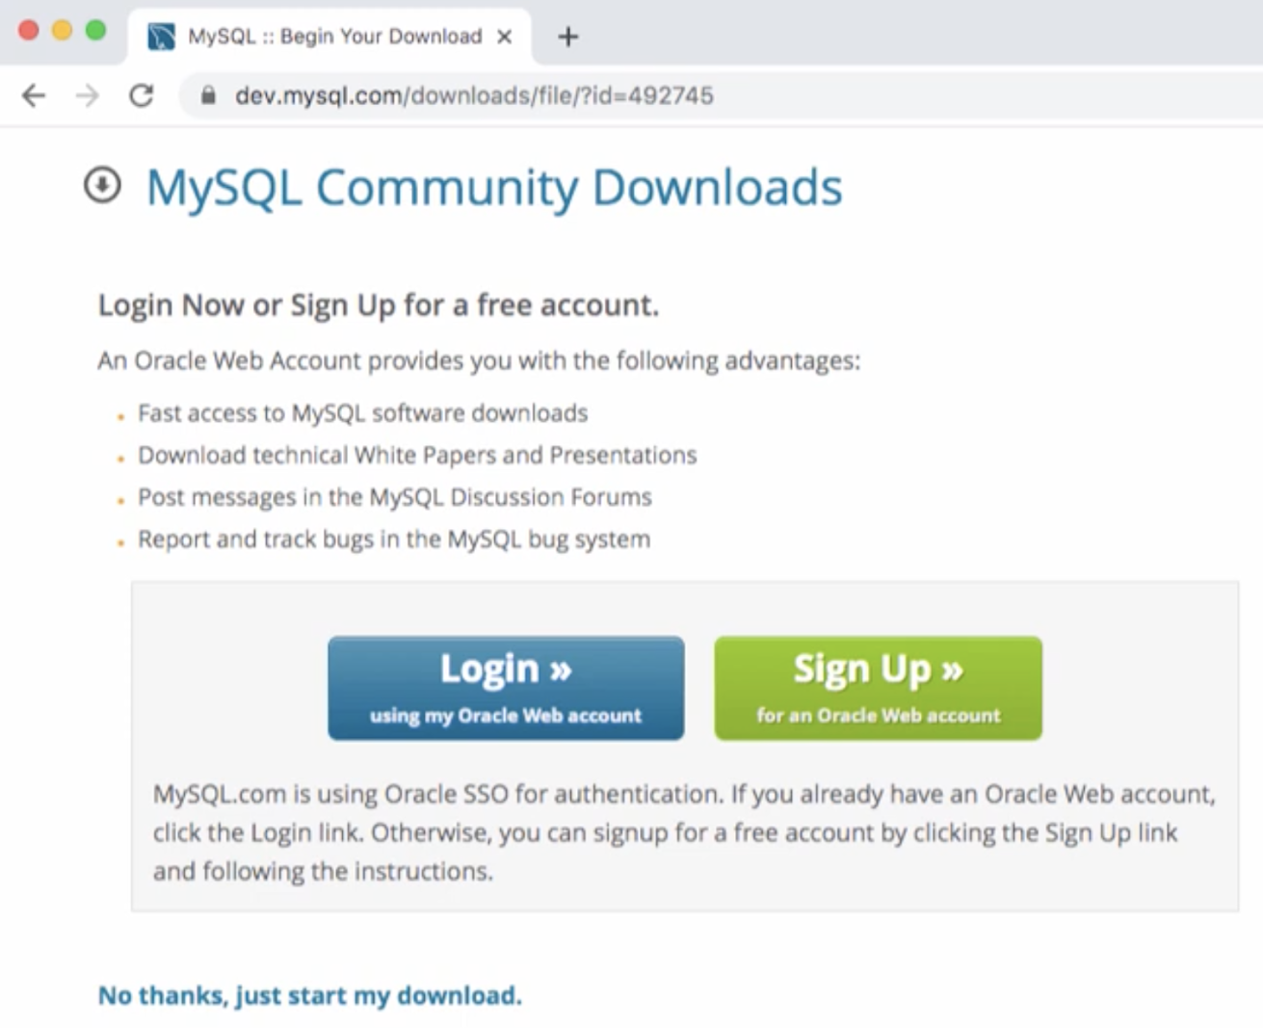
No Thanks

Slide 21
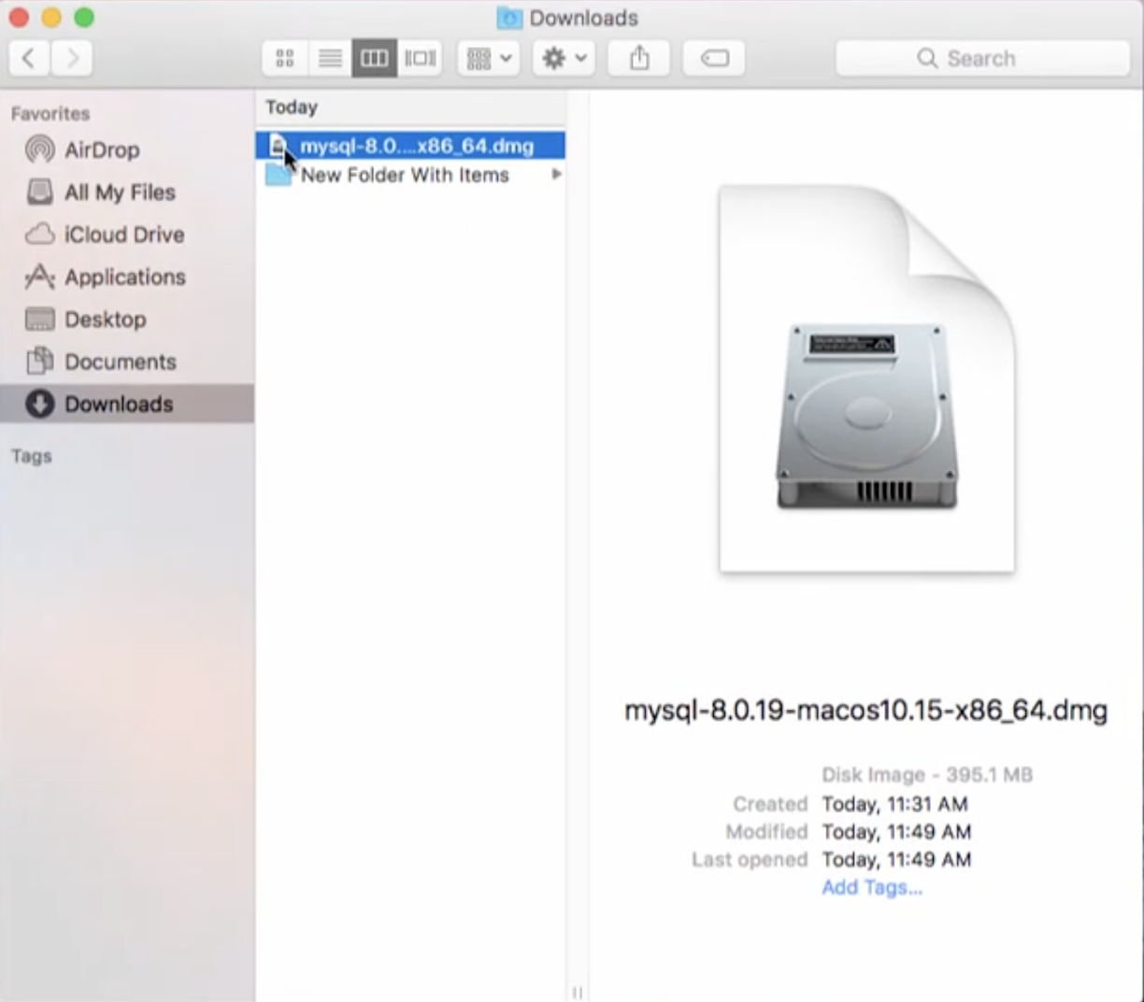
Double Click the Downloaded DMG

Slide 22
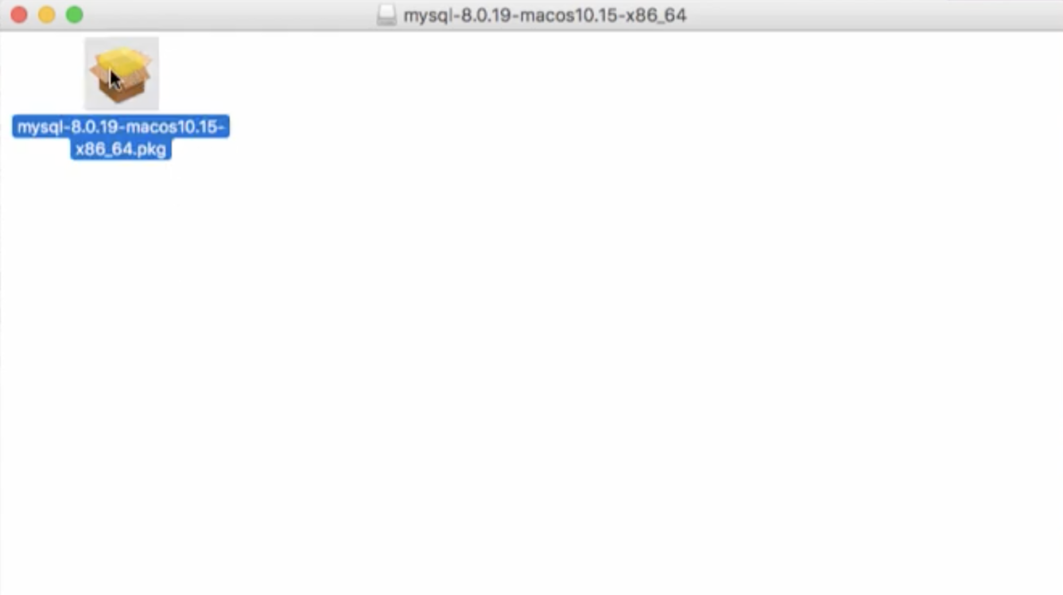
Double Click the PKG to Install

Slide 23
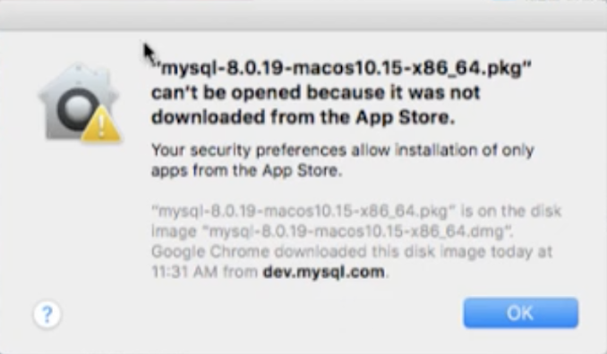
Might Have to Give Permissions

Slide 24
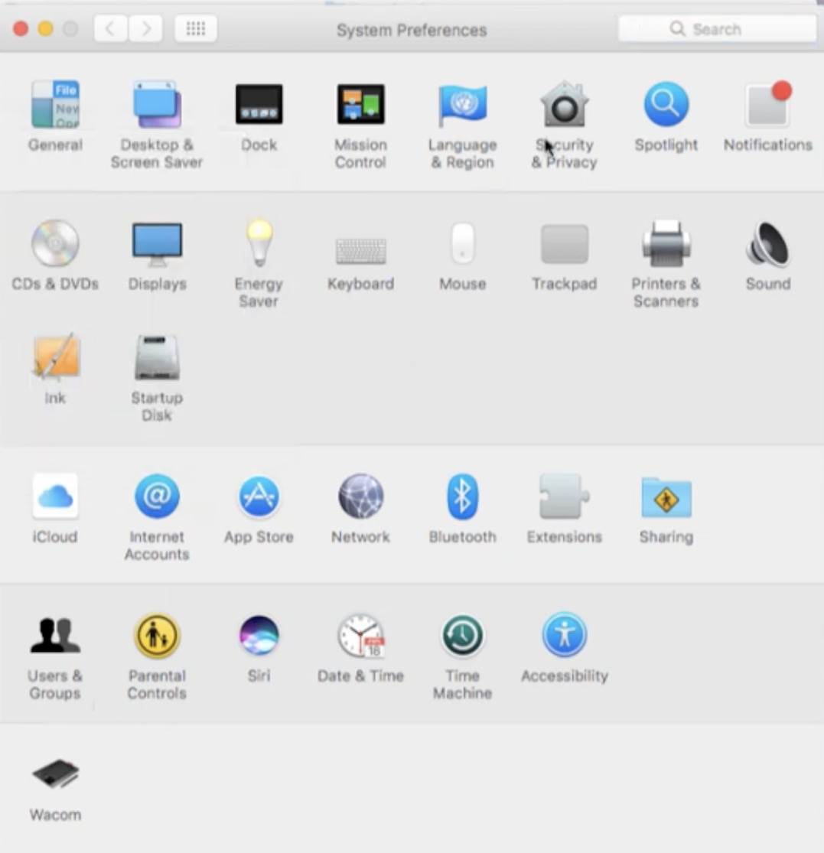
Select Security in System Preferences

Slide 25
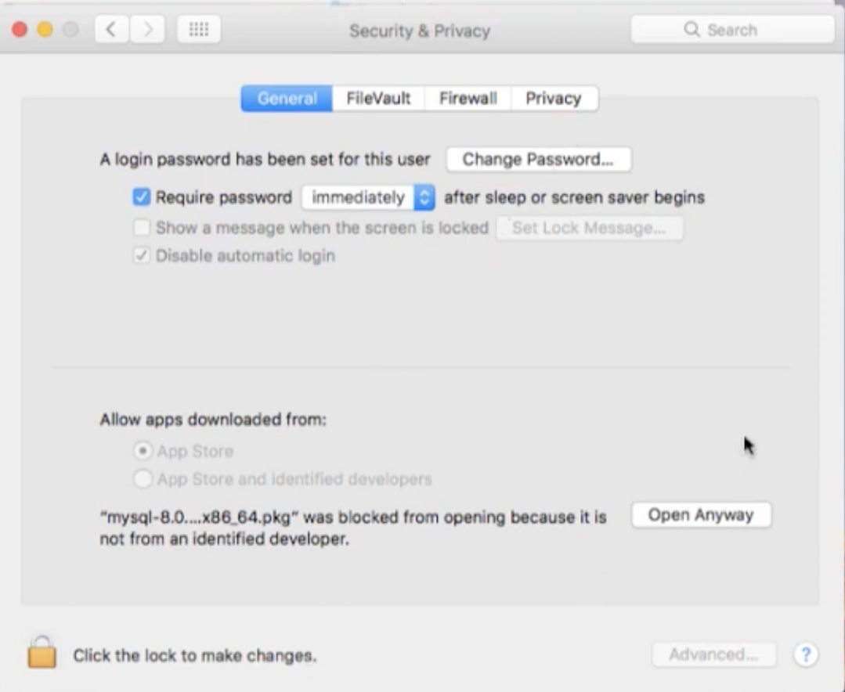
Open Anyway

Slide 26
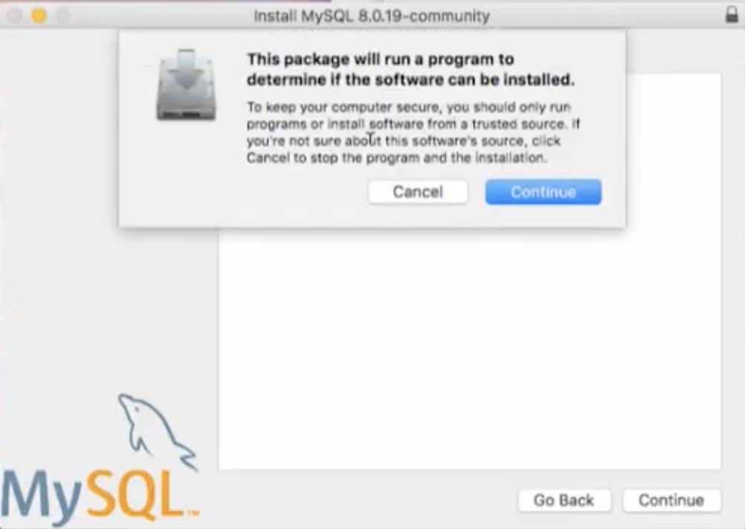
Continue

Slide 27
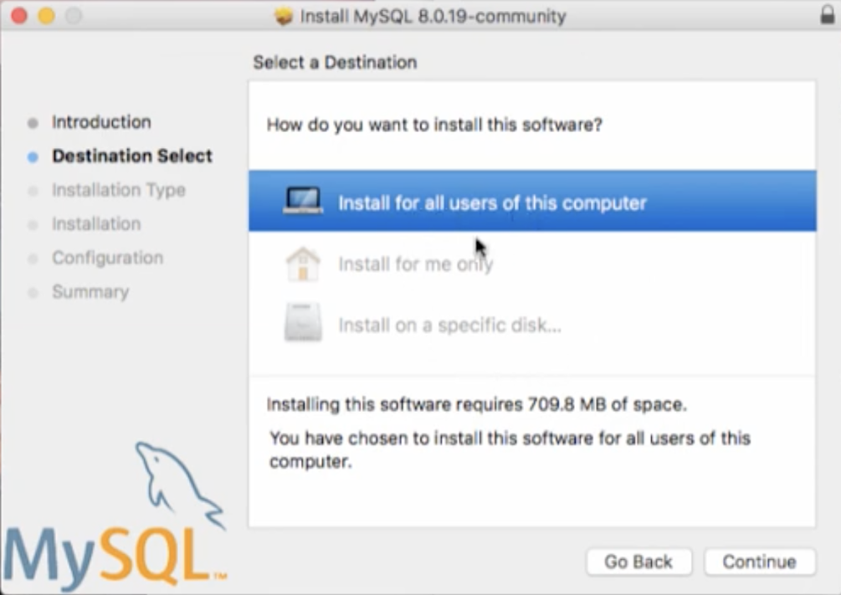
Install for All Users

Slide 28
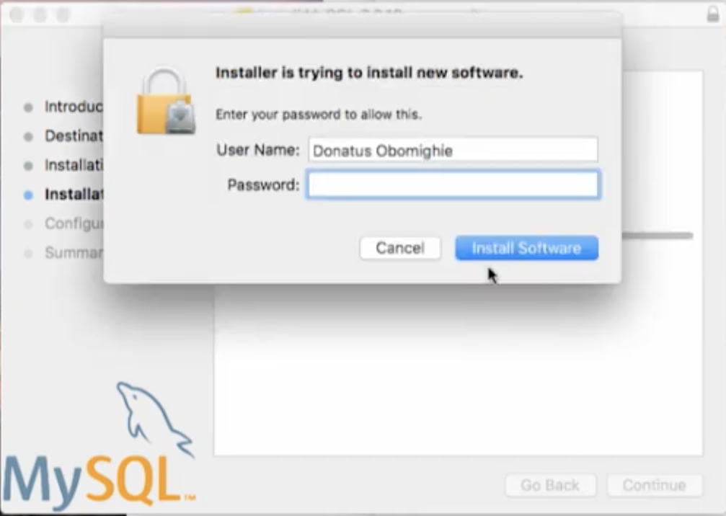
Might Need to Provide Credentials
This is your laptop's password

Slide 29
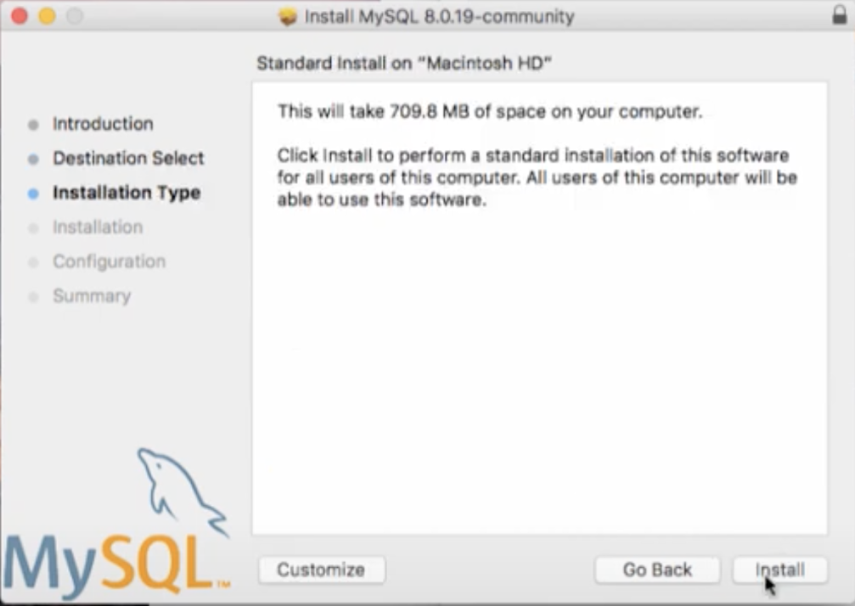
Install

Slide 30

Wait

Slide 31
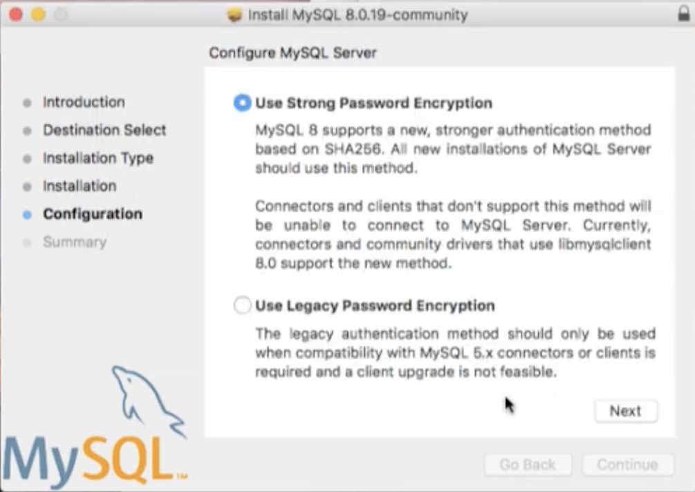
Configure Password

Slide 32

Don't Forget the Root Password!
Don't forget this password!

Slide 33
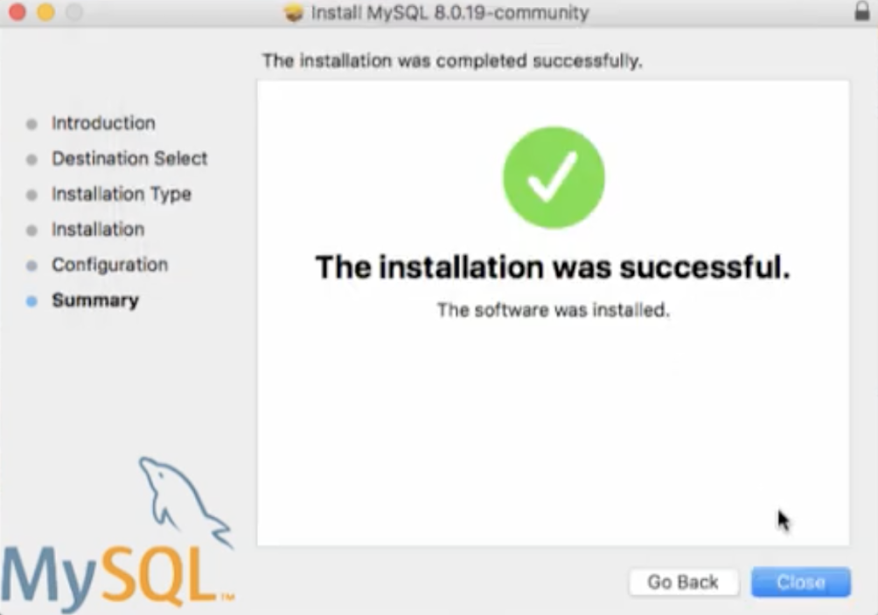
Success

Slide 34
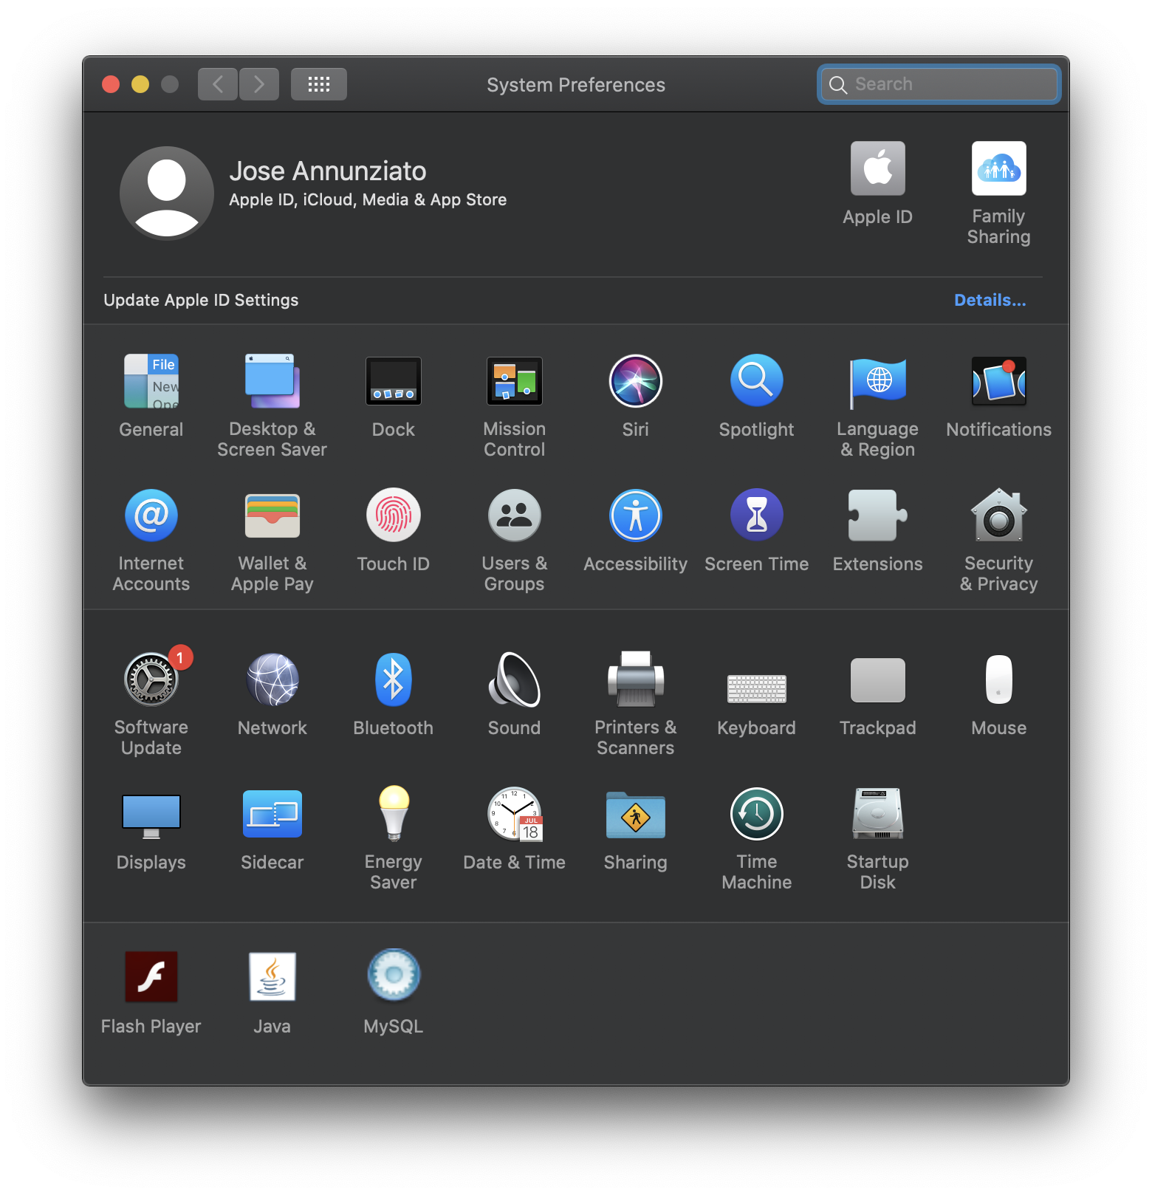
New MySQL in System Preferences

Slide 35
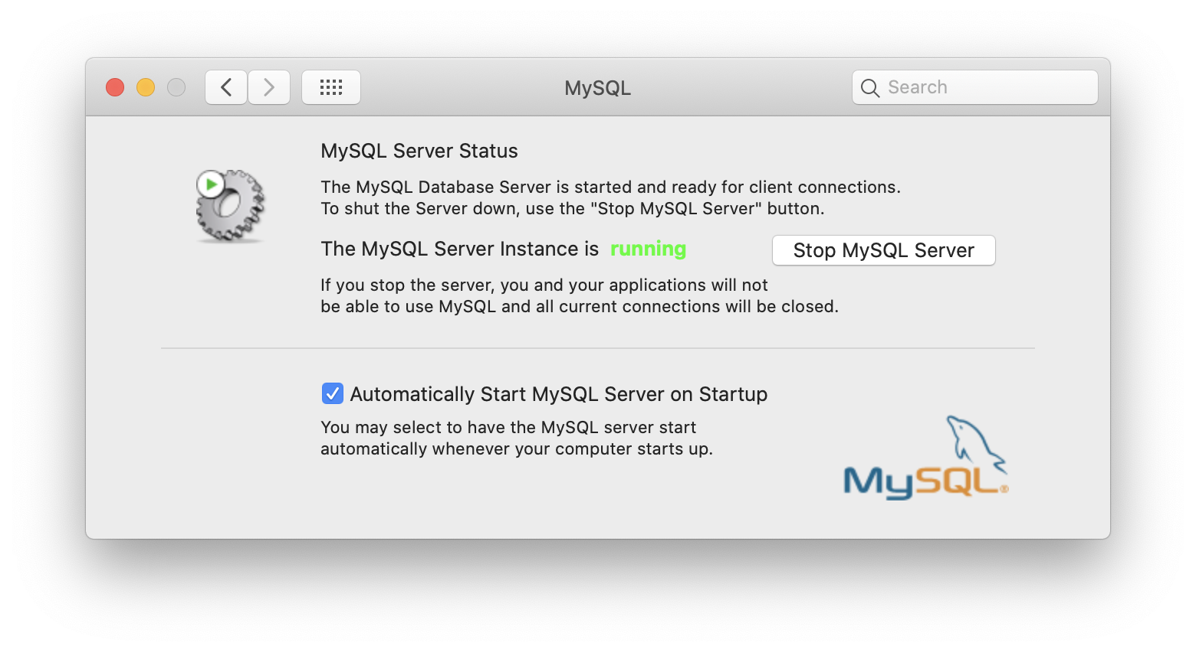
Can Start/Stop Server Manually/Auto

